Slide 1

WQD 7003 Data Analytics
CHAPTER 7 – MACHINE LEARNING
Saw Shier Nee & Hema Subramaniam
sawsn@um.edu.my, hema@um.edu.my
Dept. of AI, Fac. of Computer Science and IT, Universiti Malaya
Dept. of SE, Fac. of Computer Science and IT, Universiti Malaya

Slide 2

Outline
Supervised learning
Nearest neighbor
Decision Tree, Random Forest
Unsupervised learning
Clustering

Slide 3
Learning Outcomes
At the end of this lecture, student will be able to:
To describe the basic concepts of KNN models.
To describe the basic concepts of decision tree models.
To describe the basic concepts of clustering.

Slide 4
Nearest Neighbour Classifiers
Basic idea:
If it walks like a duck, quacks like a duck, then it’s probably a duck
Compute Distance
Test Record
Training Records
Choose k of the “nearest” records

Slide 5
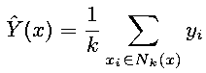
Nearest Neighbour Classifiers
Majority vote within the k nearest neighbors
new
K= 1: dark green
K= 3: green

Slide 6
Nearest Neighbour Classifiers
Requires three things
The set of stored records
Distance Metric to compute distance between records
The value of k, the number of nearest neighbors to retrieve
To classify an unknown record:
Compute distance to other training records
Identify k nearest neighbors
Use class labels of nearest neighbors to determine the class label of unknown record (e.g., by taking majority vote)

Slide 7
Nearest Neighbour Classifiers
K-nearest neighbors of a record x are data points that have the k smallest distance to x

Slide 8
Nearest Neighbour Classifiers
Compute distance between two points:
Euclidean distance
Determine the class from nearest neighbor list
take the majority vote of class labels among the k-nearest neighbors
Weigh the vote according to distance
weight factor, w = 1/d²

Slide 9

K-Nearest Neighbour (KNN) Classifiers

Slide 10
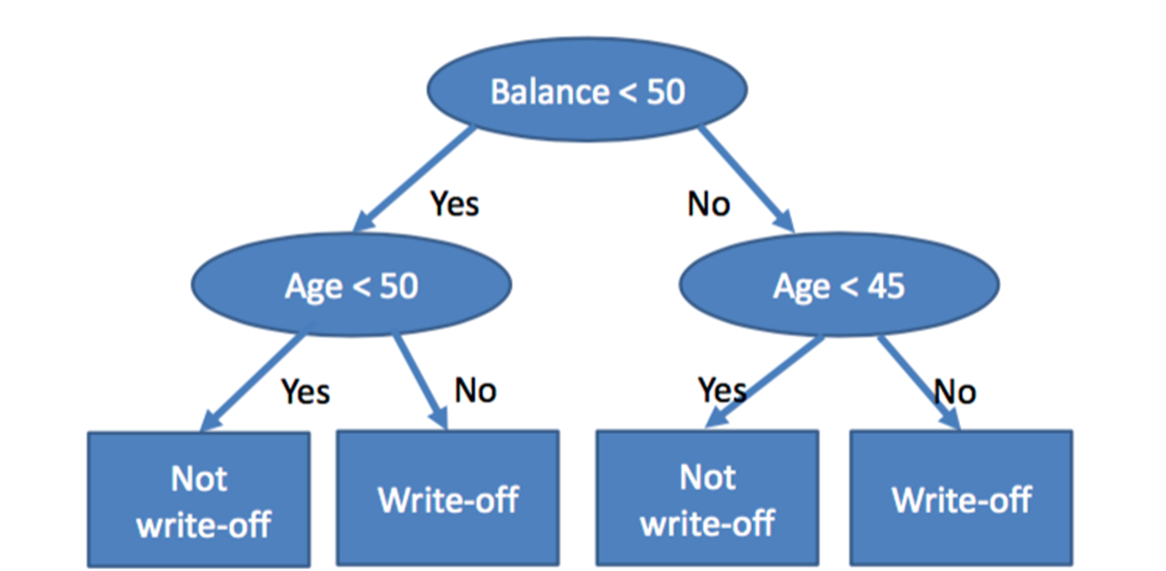
Decision Tree Classifiers
To create a training model that can use to predict the class or value of the target variable by learning simple decision rules inferred from prior data (training data)

Slide 11
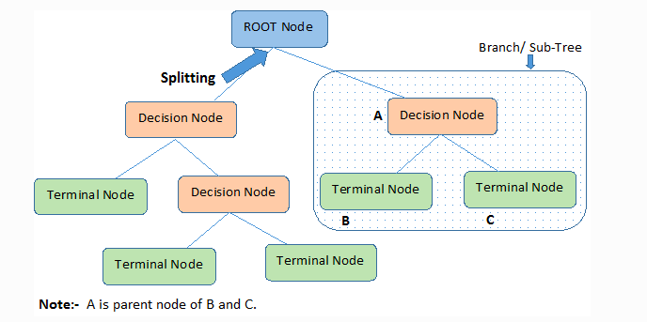
Decision Tree Classifiers - Terminology

Slide 12
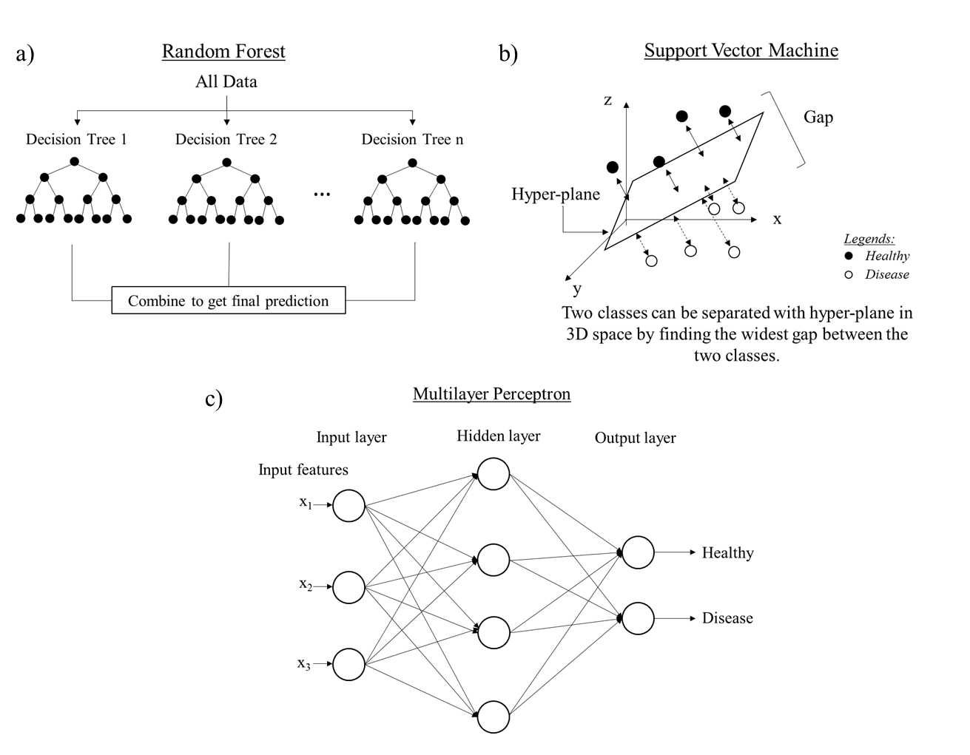
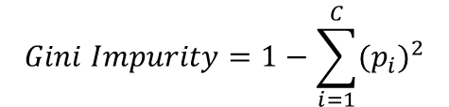
Decision Tree Classifiers
Construct the rules using Classification And Regression Tree (CART) algorithm
CART: Computing GINI Impurity in deciding the rules and algorithm
$$Gini Impurity=1−\sum_{i=1}^{C}{{{(p}_{i})}^{2}}$$

Slide 13
Decision Tree Classifiers - Example
Age | Cholesterol | Smoking | Risk of AAA
40 | 289 | Yes | High
54 | 298 | Yes | Low
65 | 300 | Yes | High
55 | 172 | No | Low
45 | 176 | No | Low
76 | 212 | No | High
77 | 281 | Yes | High
Examples: 7 Patients
Risk Factor:
Age
Cholesterol Level
Smoking
To decide the splitting, GINI Index is calculated for all risk factors.
AAA – Abdominal Aorta Aneurysm

Slide 14
Calculate Gini Impurity for Age
Age | Cholesterol | Smoking | Risk of AAA
40 | 289 | Yes | High
54 | 298 | Yes | Low
65 | 300 | Yes | High
55 | 172 | No | Low
45 | 176 | No | Low
76 | 212 | No | High
77 | 281 | Yes | High
Age >=55 → 4 patients
Age < 55 → 3 patients
AAA – Abdominal Aorta Aneurysm

Slide 15
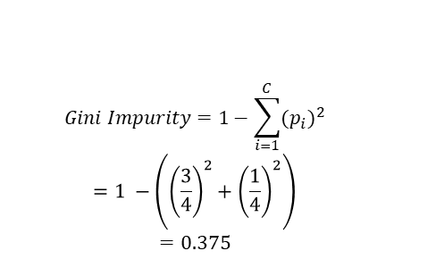
Calculate Gini Impurity for Age
Age | Cholesterol | Smoking | Risk of AAA
40 | 289 | Yes | High
54 | 298 | Yes | Low
65 | 300 | Yes | High
55 | 172 | No | Low
45 | 176 | No | Low
76 | 212 | No | High
77 | 281 | Yes | High
Age >=55 → 4 patients
Age < 55 → 3 patients
(a) (i) Age>=55 & High Risk: 3/4
(ii) Age>=55 & Low Risk: 1/4
$$Gini Impurity=1−\sum_{i=1}^{C}{{{(p}_{i})}^{2}}$$
$$=1 −\left({\left(\frac{3}{4}\right)}^{2}+{\left(\frac{1}{4}\right)}^{2}\right)$$
$$=0.375$$
AAA – Abdominal Aorta Aneurysm

Slide 16
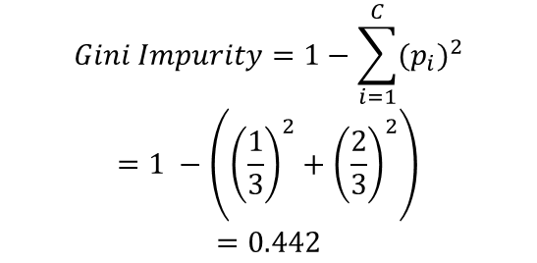
Calculate Gini Impurity for Age
Age | Cholesterol | Smoking | Risk of AAA
40 | 289 | Yes | High
54 | 298 | Yes | Low
65 | 300 | Yes | High
55 | 172 | No | Low
45 | 176 | No | Low
76 | 212 | No | High
77 | 281 | Yes | High
Age >=55 → 4 patients: 0.375
Age < 55 → 3 patients
(i) Age<55 & High Risk: 1/3
(ii) Age<55 & Low Risk: 2/3
$$Gini Impurity=1−\sum_{i=1}^{C}{{{(p}_{i})}^{2}}$$
$$=1 −\left({\left(\frac{1}{3}\right)}^{2}+{\left(\frac{2}{3}\right)}^{2}\right)$$
$$=0.442$$

Slide 17
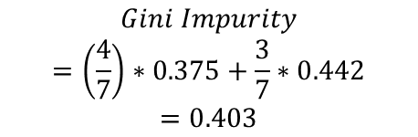
Calculate Gini Impurity for Age
Age | Cholesterol | Smoking | Risk of AAA
40 | 289 | Yes | High
54 | 298 | Yes | Low
65 | 300 | Yes | High
55 | 172 | No | Low
45 | 176 | No | Low
76 | 212 | No | High
77 | 281 | Yes | High
Age >=55 → 4 patients: 0.375
Age < 55 → 3 patients: 0.442
Sum together:
$$Gini Impurity$$
$$=\left(\frac{4}{7}\right)∗0.375+\frac{3}{7}∗0.442$$
$$=0.403$$

Slide 18
Calculate Gini Impurity for Age
Age | Cholesterol | Smoking | Risk of AAA
40 | 289 | Yes | High
54 | 298 | Yes | Low
65 | 300 | Yes | High
55 | 172 | No | Low
45 | 176 | No | Low
76 | 212 | No | High
77 | 281 | Yes | High
Gini Impurity:
Age: 0.403
Cholesterol Level
Smoking

Slide 19
Calculate Gini Impurity for all risk factors
Age | Cholesterol | Smoking | Risk of AAA
40 | 289 | Yes | High
54 | 298 | Yes | Low
65 | 300 | Yes | High
55 | 172 | No | Low
45 | 176 | No | Low
76 | 212 | No | High
77 | 281 | Yes | High
Same procedure for Cholesterol

Slide 20
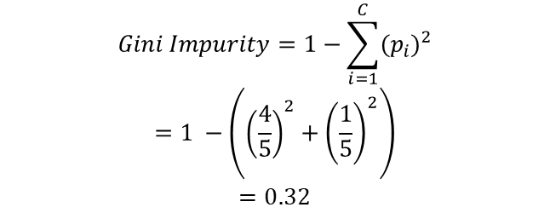
Calculate Gini Impurity for Cholesterol
Age | Cholesterol | Smoking | Risk of AAA
40 | 289 | Yes | High
54 | 298 | Yes | Low
65 | 300 | Yes | High
55 | 172 | No | Low
45 | 176 | No | Low
76 | 212 | No | High
77 | 281 | Yes | High
Choles. >=212 → 5 patients
Choles. < 212→ 2 patients
(i) Choles.>=212 & High Risk: 4/5
(ii) Choles.>=212 & Low Risk: 1/5
$$Gini Impurity=1−\sum_{i=1}^{C}{{{(p}_{i})}^{2}}$$
$$=1 −\left({\left(\frac{4}{5}\right)}^{2}+{\left(\frac{1}{5}\right)}^{2}\right)$$
$$=0.32$$

Slide 21
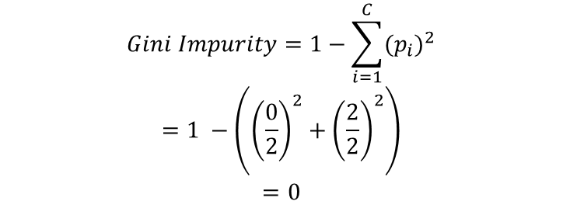
Calculate Gini Impurity for Cholesterol
Age | Cholesterol | Smoking | Risk of AAA
40 | 289 | Yes | High
54 | 298 | Yes | Low
65 | 300 | Yes | High
55 | 172 | No | Low
45 | 176 | No | Low
76 | 212 | No | High
77 | 281 | Yes | High
Choles. >=212 → 5 patients: 0.32
Choles. < 212→ 2 patients
(i) Choles.<212 & High Risk: 0/2
(ii) Choles.<212 & Low Risk: 2/2
$$Gini Impurity=1−\sum_{i=1}^{C}{{{(p}_{i})}^{2}}$$
$$=1 −\left({\left(\frac{0}{2}\right)}^{2}+{\left(\frac{2}{2}\right)}^{2}\right)$$
$$=0$$

Slide 22
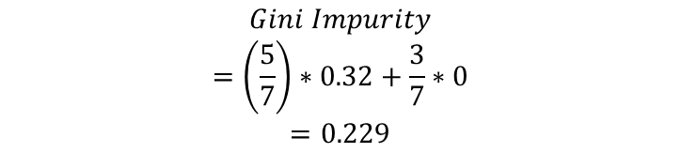
Calculate Gini Impurity for Cholesterol
Age | Cholesterol | Smoking | Risk of AAA
40 | 289 | Yes | High
54 | 298 | Yes | Low
65 | 300 | Yes | High
55 | 172 | No | Low
45 | 176 | No | Low
76 | 212 | No | High
77 | 281 | Yes | High
Choles. >=212 → 5 patients: 0.32
Choles. < 212→ 2 patients: 0
Sum together:
$$Gini Impurity$$
$$=\left(\frac{5}{7}\right)∗0.32+\frac{3}{7}∗0$$
$$=0.229$$

Slide 23
Calculate Gini Impurity for all risk factors
Age | Cholesterol | Smoking | Risk of AAA
40 | 289 | Yes | High
54 | 298 | Yes | Low
65 | 300 | Yes | High
55 | 172 | No | Low
45 | 176 | No | Low
76 | 212 | No | High
77 | 281 | Yes | High
Same procedure for Smoking

Slide 24
Gini Impurity of Risk Factors
Age | Cholesterol | Smoking | Risk of AAA
40 | 289 | Yes | High
54 | 298 | Yes | Low
65 | 300 | Yes | High
55 | 172 | No | Low
45 | 176 | No | Low
76 | 212 | No | High
77 | 281 | Yes | High
Calculate Gini Impurity for all risk factor:
Age: 0.403
Cholesterol Level: 0.228
Smoking: 0.403
Lowest
First Rule will be cholesterol level

Slide 25
Decision Trees Construction
Cholesterol
>=212
212
5 patients:
4 high risk, 1 low risk
Low Risk
2 patients:
2 low risk
Repeat the process again to find the next rule

Slide 26
Decision Trees Construction
Cholesterol
>=212
<212
Age
Low Risk
>=55
<55
2 patients:
2 low risk
High Risk
2 patients:
1 high risk, 1 low risk
3 patients:
3 high risk

Slide 27
Decision Trees Construction
Cholesterol
>=212
<212
Age
Low Risk
>=55
<55
2 patients:
2 low risk
High Risk
Smoking
Yes
No
3 patients:
3 high risk
High Risk
Low Risk

Slide 28
Decision Tree
Advantages:
Understand the diagnosis rule
Disadvantages:
Overfitting due to very complex rule
Couldn’t generalize the population
To overcome:
Random forest is proposed.

Slide 29
Random Forest
Random Forest
Constructs multiple of decision trees and make a majority voting to get the final prediction.
Averaging approach.
Multiple Decision Trees

Slide 30
Hierarchical Agglomerative Clustering
We start with every data point in a separate cluster
We keep merging the most similar pairs of data points/clusters until we have one big cluster left
This is called a bottom-up or agglomerative method

Slide 31
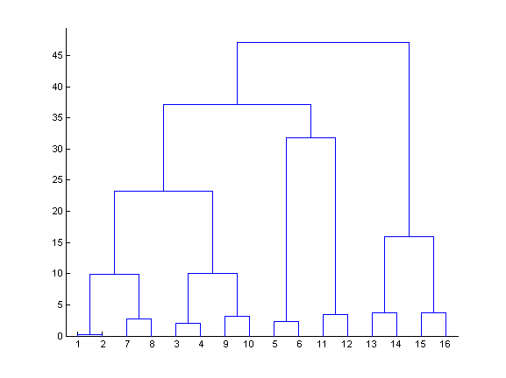
Hierarchical Agglomerative Clustering
This produces a binary tree or dendrogram
The final cluster is the root and each data item is a leaf
The height of the bars indicate how close the items are

Slide 32
Dendogram
The dendrogram
is a tree diagram that displays the groups that are formed by clustering observations at each step and their similarity levels.
The similarity level is measured along the vertical axis (alternately, you can display the distance level).
The different observations are listed along the horizontal axis.

Slide 33
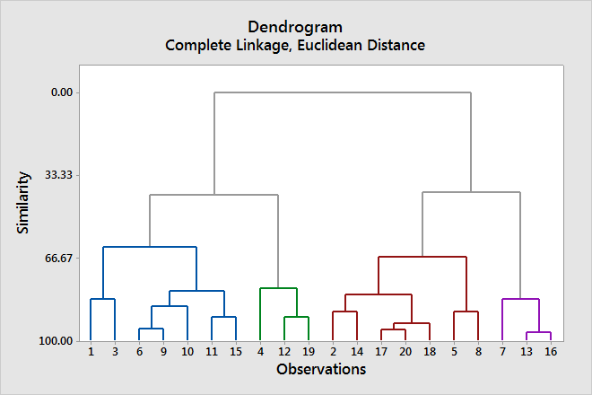
Dendogram

Slide 34
Dendogram
This dendrogram was created using a final partition of 4 clusters, which occurs at a similarity level of approximately 40.
The first cluster (far left) is composed of seven observations (the observations in rows 1, 3, 6, 9, 10, 11, and 15 of the worksheet).
The second cluster, directly to the right, is composed of 3 observations (the observations in rows 4, 12, and 19 in the worksheet).
The third cluster is composed of 7 observations (the observations in rows 2, 14, 17, 20, 18, 5, and 8).
The fourth cluster, on the far right, is composed of 3 observations (the observations in rows 7, 13, and 16).
If you cut the dendrogram higher, then there would be fewer final clusters, but their similarity level would be lower.
If you cut the dendrogram lower, then the similarity level would be higher, but there would be more final clusters.

Slide 35
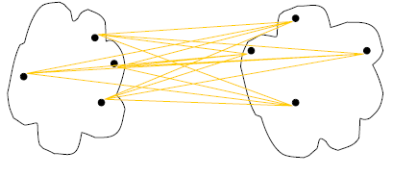
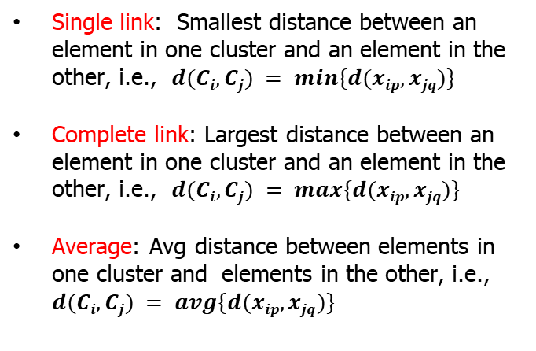
Cluster Distance Measures
single link
(min)
Single link: Smallest distance between an element in one cluster and an element in the other, i.e., $d(Ci, Cj) = min⁡\{d(xip, xjq)\}$
Complete link: Largest distance between an element in one cluster and an element in the other, i.e., $d(Ci, Cj) = max⁡\{d(xip, xjq)\}$
Average: Avg distance between elements in one cluster and elements in the other, i.e., $d(Ci, Cj) = avg\{d(xip, xjq)\}$
complete link
(max)
average
Notes:
Define D(C, C)=0, the distance between two exactly same clusters is ZERO!

Slide 36
Single Linage
Also, known as the nearest neighbor technique
Distance between groups is defined as that of the closest pair of data, where only pairs consisting of one record from each group are considered
Cluster B
Cluster A

Slide 37
Hierarchical Agglomerative Clustering :Single Linkage
1
2
3
4
5
(12)
3
4
5
1
(12)
2
3
3
4
4
5
5
Dendrogram
2
1
5.0
4.0
3.0
2.0
1.0
0
Distance

Slide 38
Hierarchical Agglomerative Clustering :Single Linkage
(12)
3
4
5
(12)
3
(4 5)
(12)
(12)
3
3
4
(4 5)
5
Dendrogram
5
4
2
1
5.0
4.0
3.0
2.0
1.0
0
Distance

Slide 39
Hierarchical Agglomerative Clustering :Single Linkage
(12)
3
(4 5)
(12)
(12)
(3 4 5)
3
(12)
(4 5)
(3 4 5)
Dendrogram
5
4
3
2
1
5.0
4.0
3.0
2.0
1.0
0
Distance

Slide 40
Hierarchical Agglomerative Clustering :Single Linkage
(12)
(3 4 5)
(12)
(3 4 5)
Dendrogram
5
4
3
2
1
5.0
4.0
3.0
2.0
1.0
0
Distance

Slide 41
Dendogram
The decision about final grouping is also called cutting the dendrogram.
Cutting the dendrogram is similar to drawing a line across the dendrogram to specify the final grouping.
You can also compare dendrograms for different final groupings to determine which final grouping makes the most sense for your data.
The decision of the no. of clusters that can best depict different groups can be chosen by observing the dendrogram.
The best choice of the no. of clusters is the no. of vertical lines in the dendrogram cut by a horizontal line that can transverse the maximum distance vertically without intersecting a cluster.

Slide 42
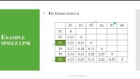
Hierarchical Agglomerative Clustering :Single Linkage

Slide 43
K-means Clustering
Iterate:
Assign/cluster each example to closest center
Recalculate centers as the mean of the points in a cluster
iterate over each point:
- get distance to each cluster center
- assign to closest center (hard cluster)
What distance measure should we use?

Slide 44
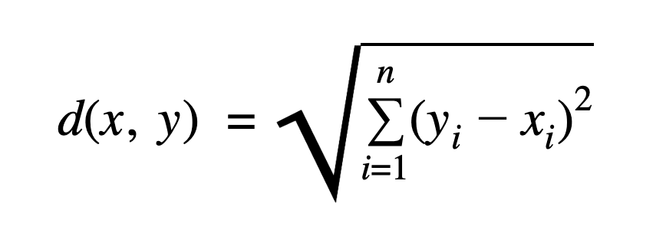
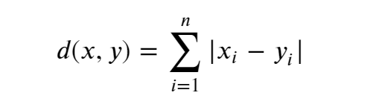
Common Distance measures:
Distance measure will determine how the similarity of two elements is calculated and it will influence the shape of the clusters.
They include:
The Euclidean distance is given by:
The Manhattan distance is given by:

Slide 45
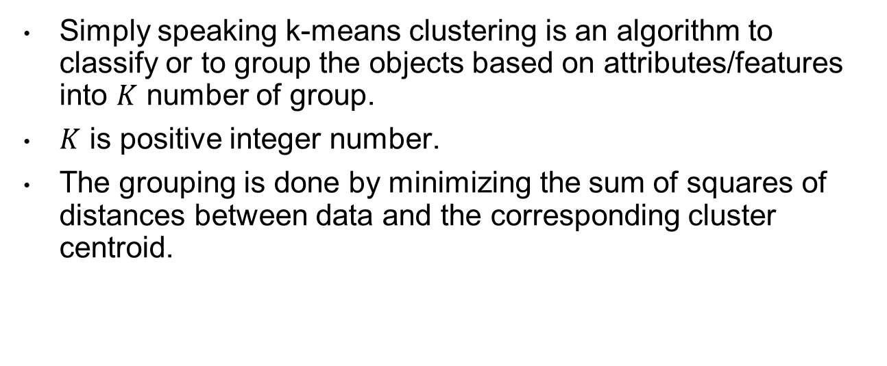
K-Means Clustering
Simply speaking k-means clustering is an algorithm to classify or to group the objects based on attributes/features into $K$ number of group.
$K$ is positive integer number.
The grouping is done by minimizing the sum of squares of distances between data and the corresponding cluster centroid.

Slide 46
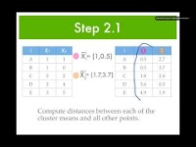
K-Means Clustering

Slide 47
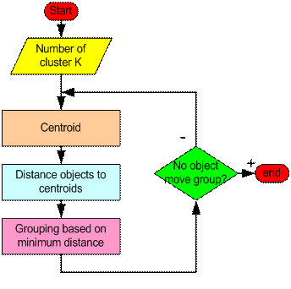
How the K-Mean Clustering algorithm works?

Slide 48
How the K-Mean Clustering algorithm works?
Step 1: Begin with a decision on the value of k = number of clusters .
Step 2: Put any initial partition that classifies the data into k clusters. You may assign the training samples randomly, or systematically as the following:
Take the first k training sample as single-element clusters
Assign each of the remaining (N-k) training sample to the cluster with the nearest centroid. After each assignment, recompute the centroid of the gaining cluster.

Slide 49
How the K-Mean Clustering algorithm works?
Step 3: Take each sample in sequence and compute its distance from the centroid of each of the clusters. If a sample is not currently in the cluster with the closest centroid, switch this sample to that cluster and update the centroid of the cluster gaining the new sample and the cluster losing the sample.
Step 4 . Repeat step 3 until convergence is achieved, that is until a pass through the training sample causes no new assignments.

